Slide 1
Basics on machine learning and data analysis using python
8.8.18

Slide 2
Python environment
Python example
Wine data

Slide 3
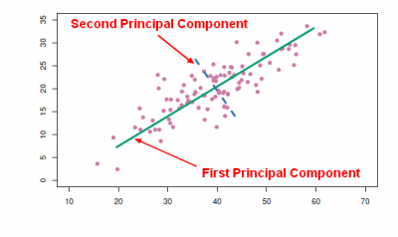
Principle component analysis

Slide 4
Outline
Machine learning
Definition
Concepts
Evaluation metrics
Supervised learning framework
Wine classification

Slide 5
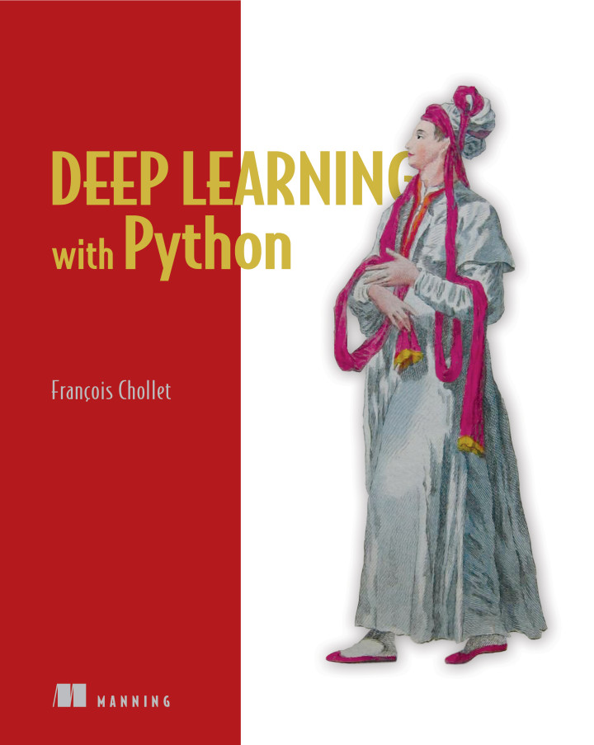
Machine learning some resources
Andrew Ng
Machine learning: online course
Francois Chollet
Deep learning with python

Slide 6
Definition
A computer program is said to learn from experience E with respect to some class of tasks T and performance measure P, if its performance at tasks in T, as measured by P, improves with experience E -- Tom Mitchell
From experience (historical records) find principles, and do better
Machine learning is the science of getting computers to act without being explicitly programmed -- Arthur Samuel
Solve the problem by patterns discovered from data

Slide 7
Supervised learning
Data
Factors
Labels
Model
Predictions
Difference
Unsupervised learning Reinforcement learning
Complexity
Optimizer
Minimization
objective

Slide 8
Examples (recent advances)
Image recognition
Millions of labelled images in 1000 classes(Experience)
5 guess error, less than 5% (random guess 99.5%)

Slide 9
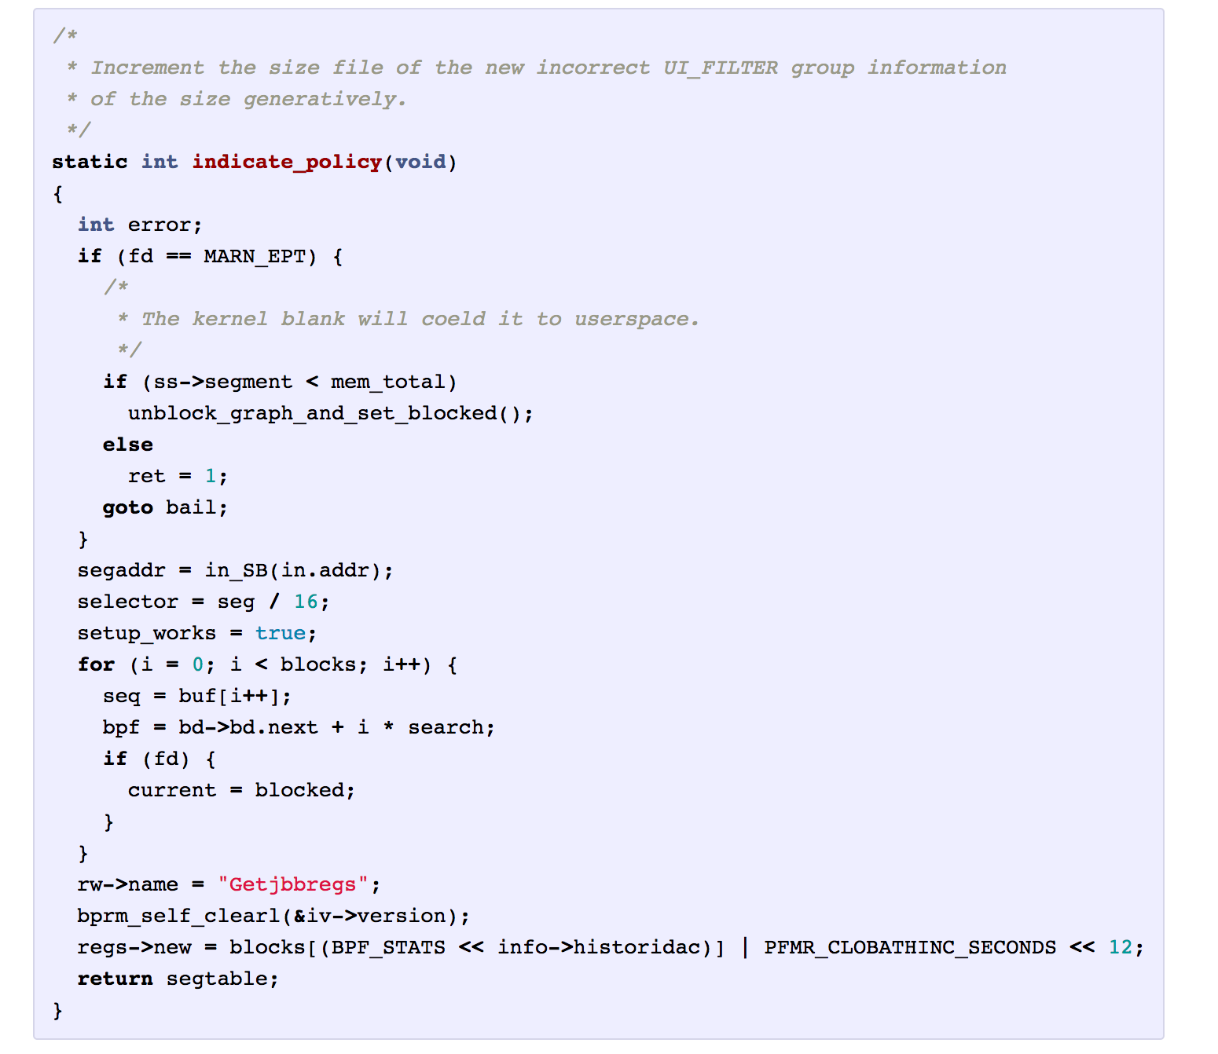
Examples
Code writing
Training (experience):
200 characters → successive 1 character
Testing:
[1, 200] → 201
[2, 201] → 202
…

Slide 10
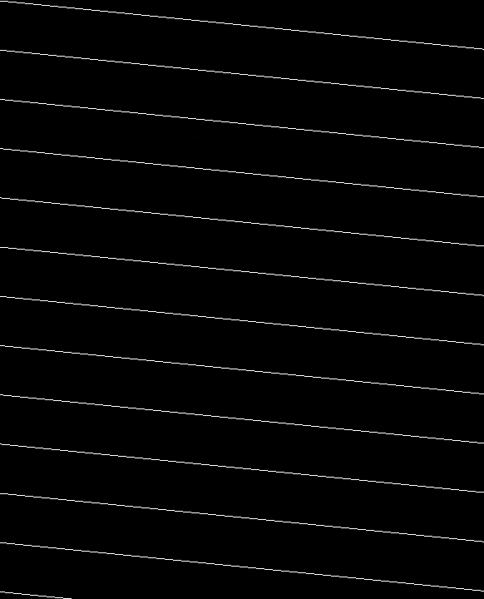
Examples
Game
Reinforcement learning

Slide 11
Training data and testing data
Back testing manner
Data (factors and labels) of May and June as training data
Model from training data
Data (factors and labels) of July as testing data
Feed factors into model, get predictions
Evaluation of predictions: difference between labels and predictions

Slide 12
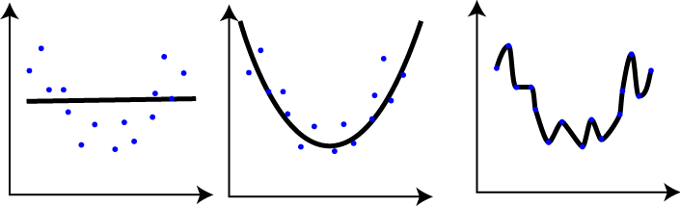
True patterns behind data OR data fitting
The more complex a model is → the better it fits the training data & the more inconsistent its performance on training data and testing data
Description ability of model: under fitting and over fitting

Slide 13
Supervised learning
Data
Factors
Labels
Model
Predictions
Difference
Complexity
Optimizer
Minimization
objective

Slide 14

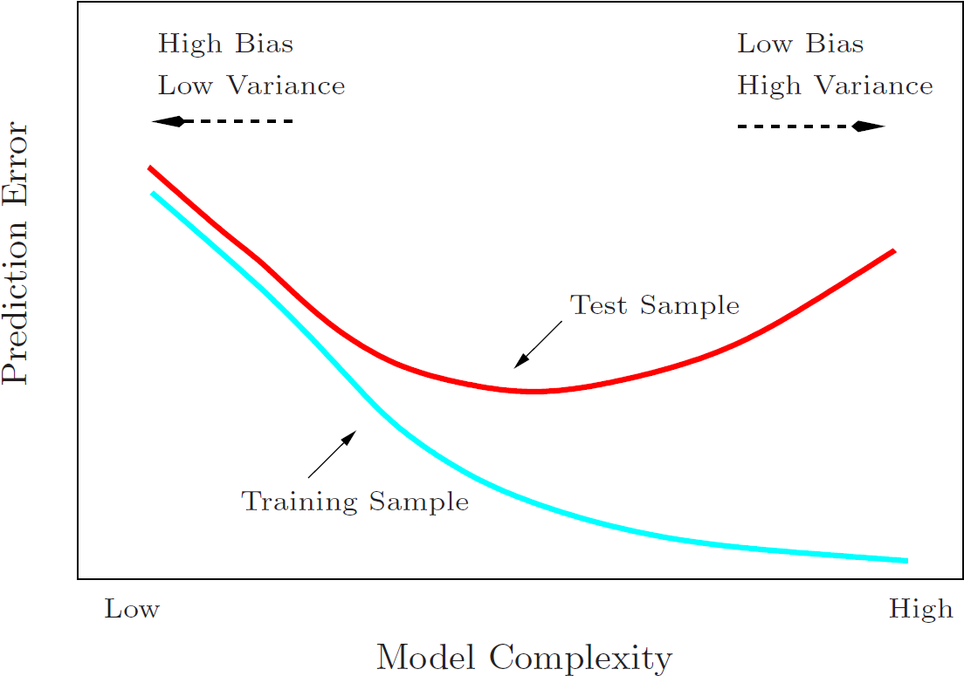
Model generalization: bias and variance
Bias: differences between labels and predictions on training data
Accuracy of predictions
Variance: prediction differences of models on testing data when trained from different training data sets
Consistency of learning

Slide 15
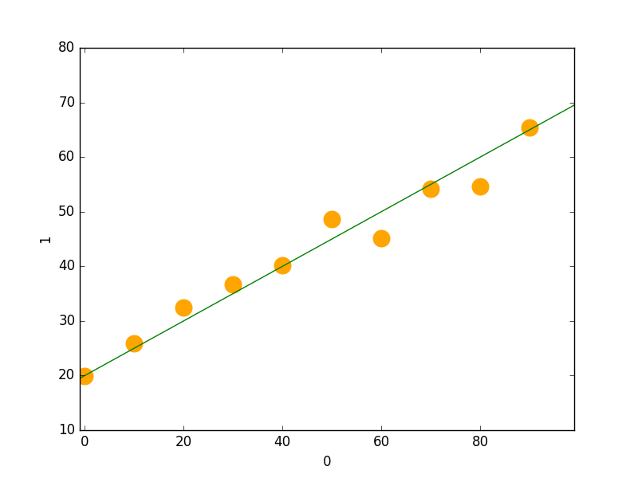
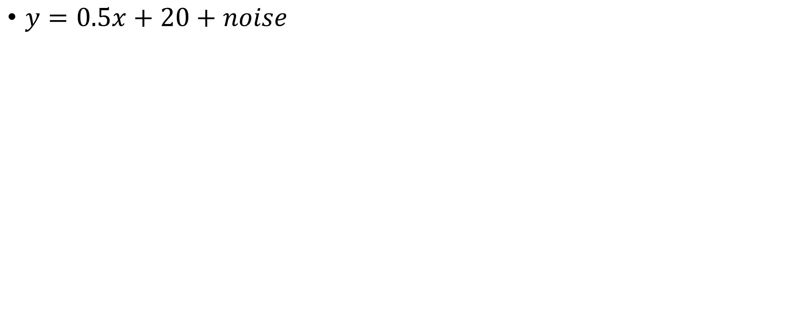
$y=0.5x+20+noise$

Slide 16
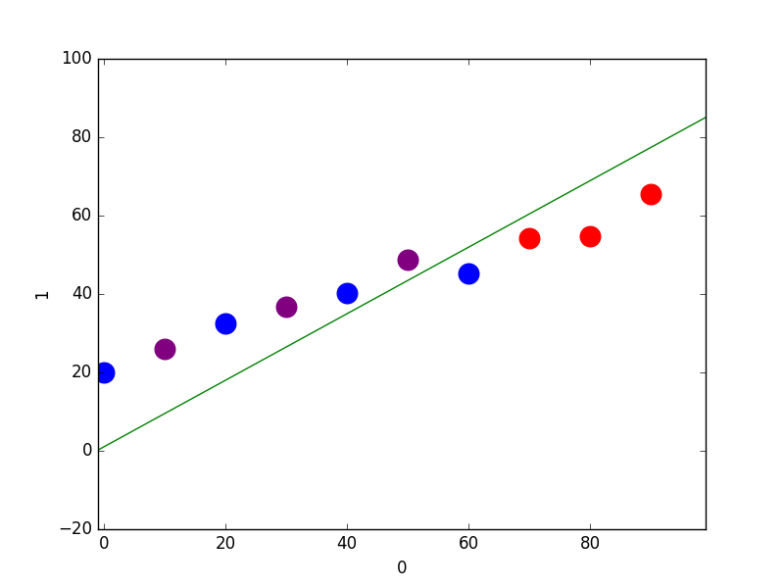
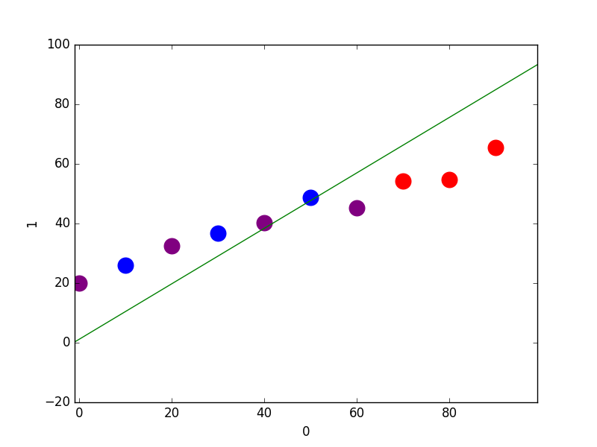
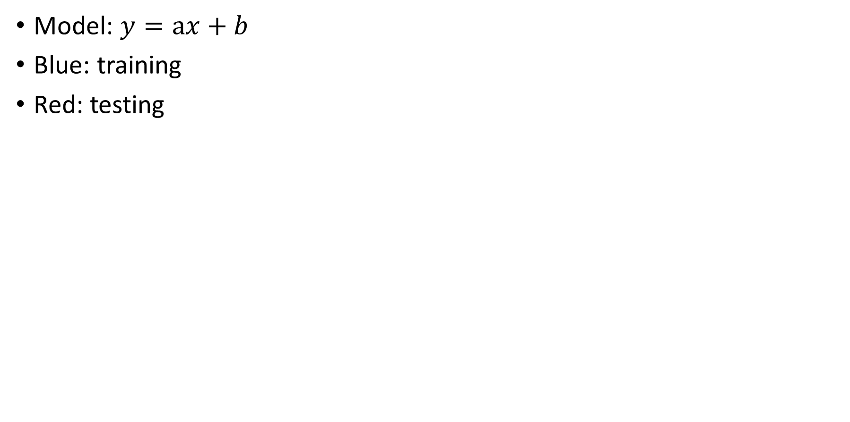
Model: $y=ax+b$
Blue: training
Red: testing

Slide 17
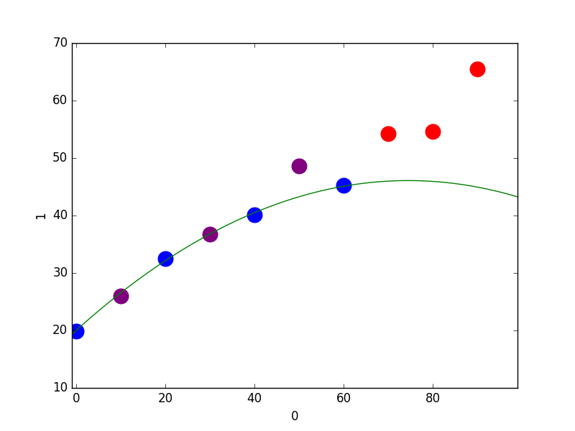
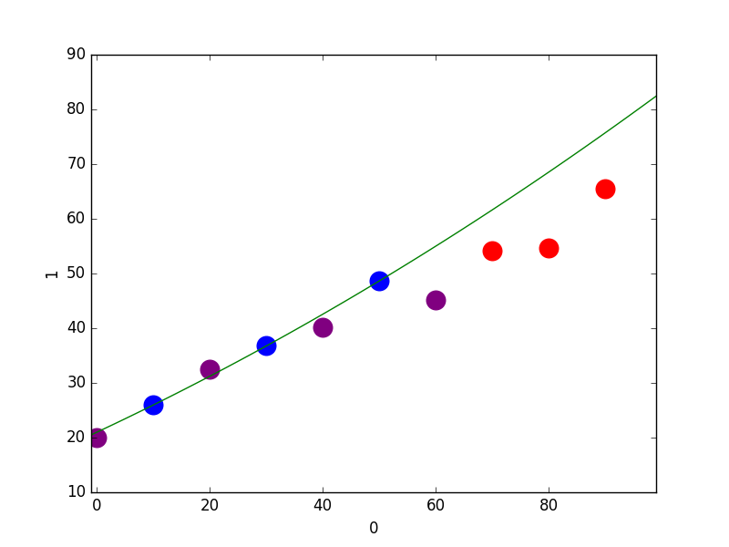
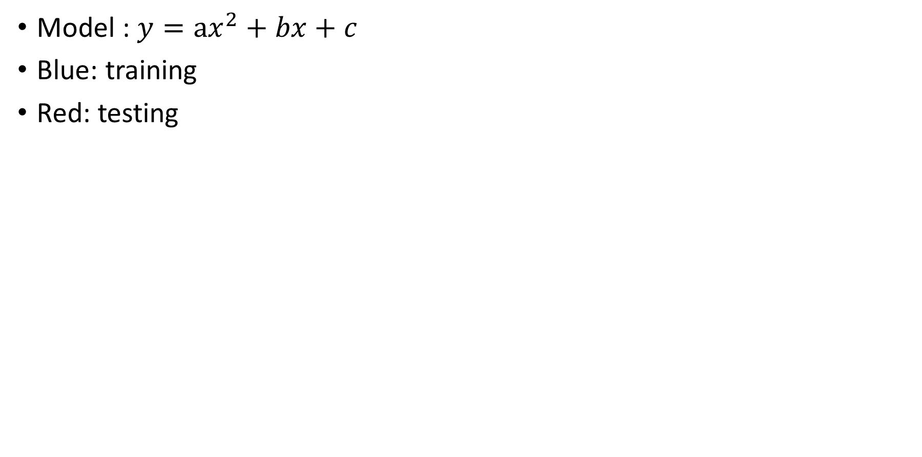
Model : $y=ax^{2}+bx+c$
Blue: training
Red: testing

Slide 18
Model generalization
Proper complexity
Regularization
Early stopping
Dropout
Compare training-data and testing-data performance during training

Slide 19
Evaluation of machine learning methods
Regression
Classification
Accuracy
Precision and recall

Slide 20
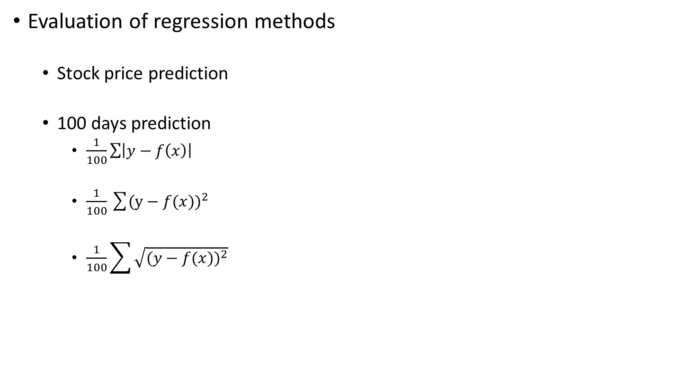
Evaluation of regression methods
Stock price prediction
100 days prediction
$\frac{1}{100}\sum{\left|y−f\left(x\right)\right|}$
$\frac{1}{100}\sum{(y}−f{(x))}^{2}$
$\frac{1}{100}\sum{\sqrt{(y−f{(x))}^{2}}}$

Slide 21
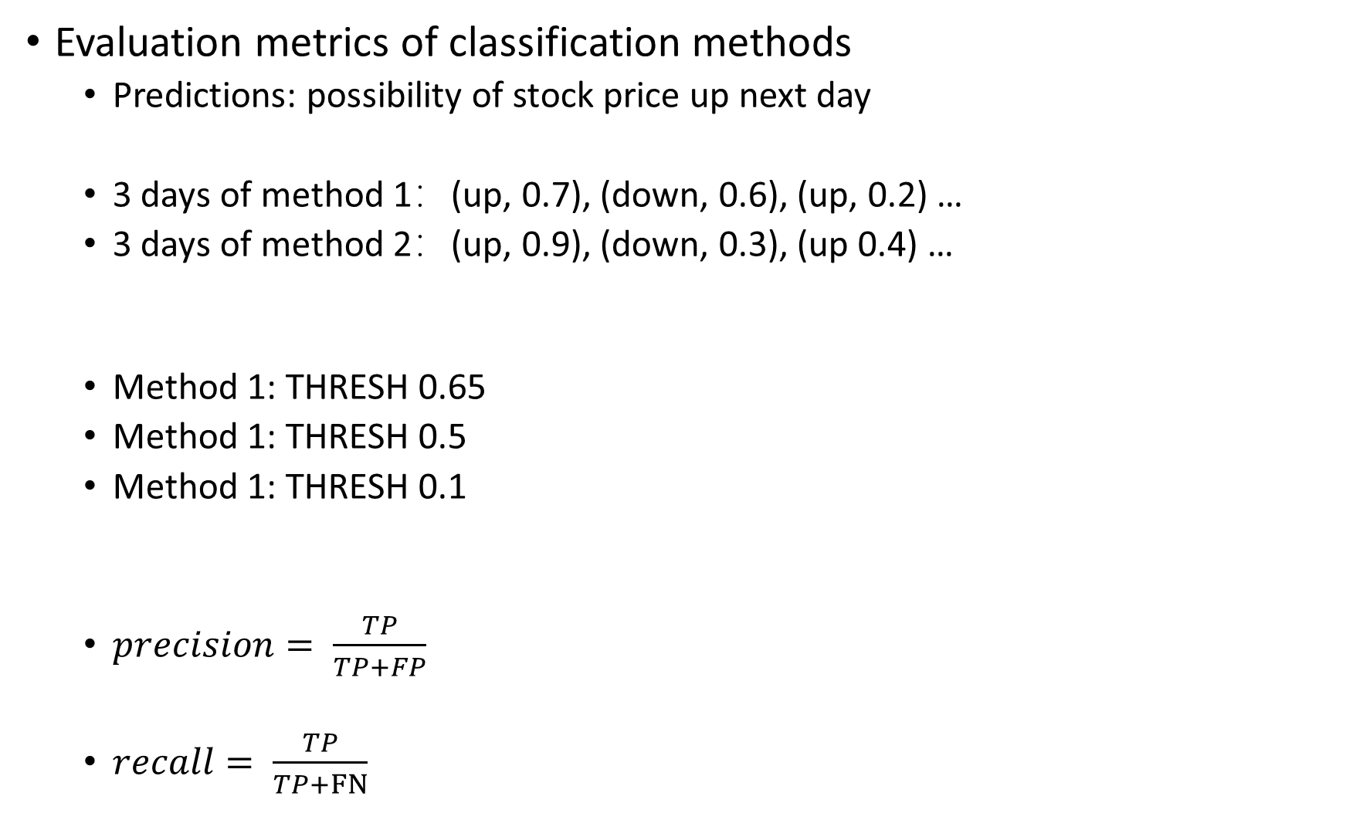
Evaluation metrics of classification methods
Predictions: possibility of stock price up next day
3 days of method 1：(up, 0.7), (down, 0.6), (up, 0.2) …
3 days of method 2：(up, 0.9), (down, 0.3), (up 0.4) …
Method 1: THRESH 0.65
Method 1: THRESH 0.5
Method 1: THRESH 0.1
$precision= \frac{TP}{TP+FP}$
$recall= \frac{TP}{TP+FN}$
Labels | Predictions
 | Positive on THRESH | Negative on THRESH
Positive | TP (TRUE P) | FN (FALSE N)
Negative | FP (FALSE P) | TN (TRUE N)

Slide 22
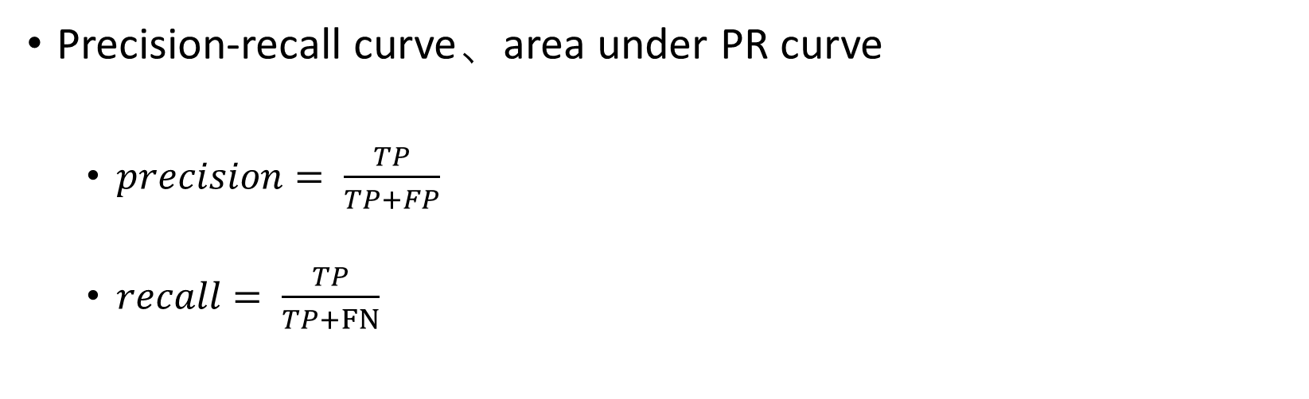
Labels | Predictions
 | Positive on THRESH | Negative on THRESH
Positive | TP (TRUE P) | FN (FALSE N)
Negative | FP (FALSE P) | TN (TRUE N)
Precision-recall curve、area under PR curve
$precision= \frac{TP}{TP+FP}$
$recall= \frac{TP}{TP+FN}$

Slide 23
Linear regression

Slide 24
Supervised learning
Data
Factors
Labels
Model
Predictions
Difference
Complexity
Optimizer
Minimization
objective

Slide 25
Data: factors and labels

Slide 26
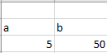

Model: $y=ax+b$

Slide 27
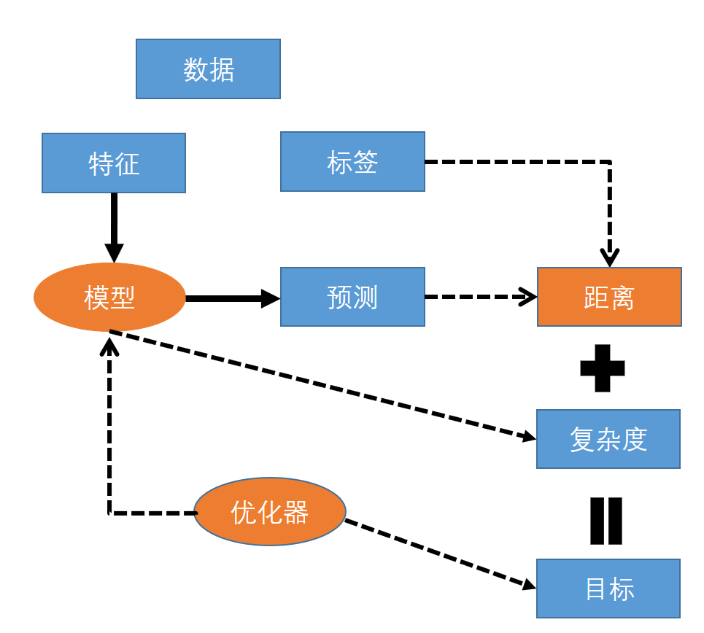
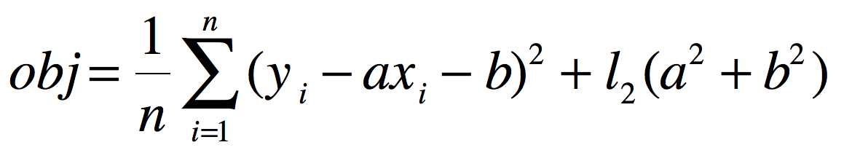
目标

Slide 28
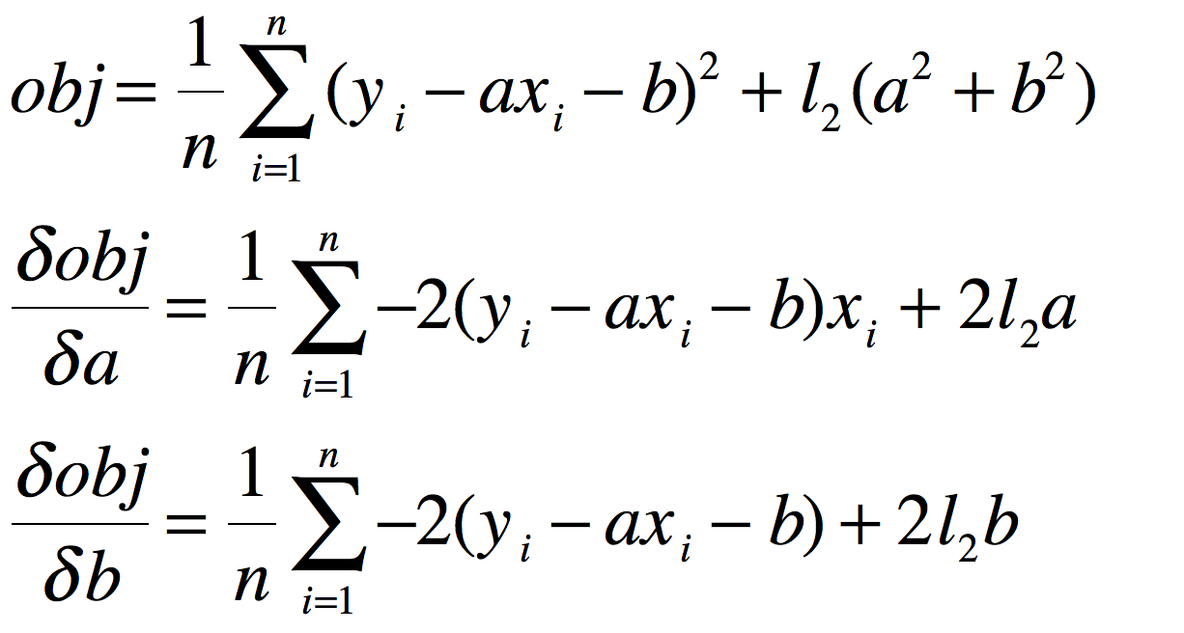
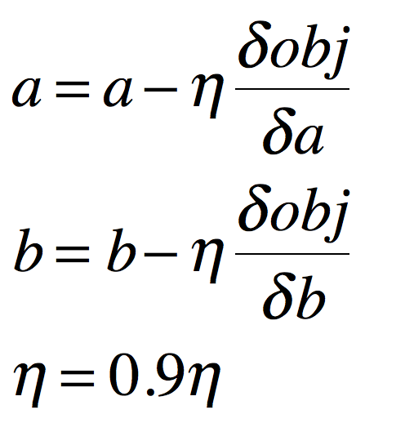
Optimizer: gradient descent
Find gradients to all the data and gradient descent

Slide 29
Optimization method
无约束凸优化的一阶方法：线搜索
无约束凸优化的二阶方法：牛顿法
随机梯度下降

Slide 30
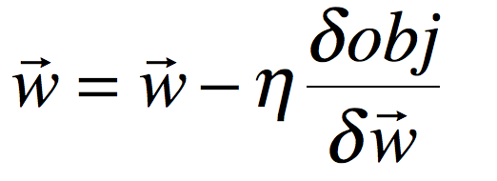
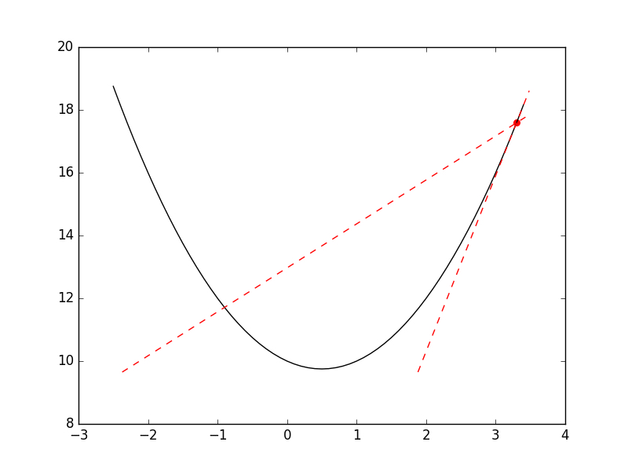
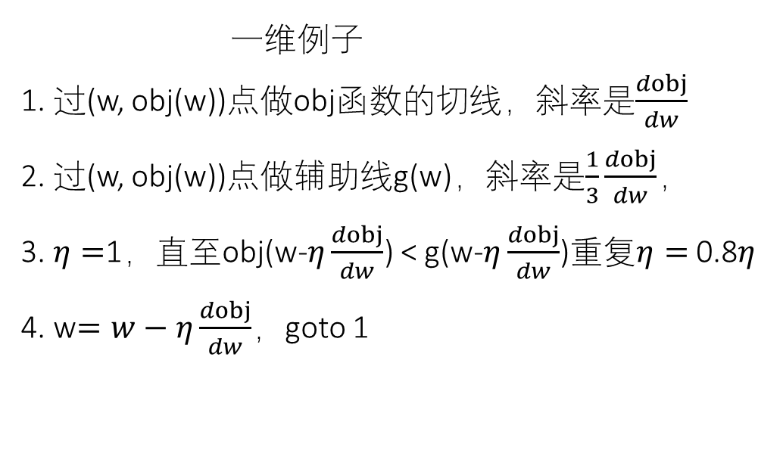
线搜索 无约束凸优化的一阶方法
一维例子
1. 过(w, obj(w))点做obj函数的切线，斜率是$\frac{dobj}{dw}$
2. 过(w, obj(w))点做辅助线g(w)，斜率是$\frac{1}{3}\frac{dobj}{dw}$，
3. $η=$1，直至obj(w-$η\frac{dobj}{dw}$) < g(w-$η\frac{dobj}{dw}$)重复$η=$0.8$η$
4. w$=w−η\frac{dobj}{dw}$，goto 1

Slide 31
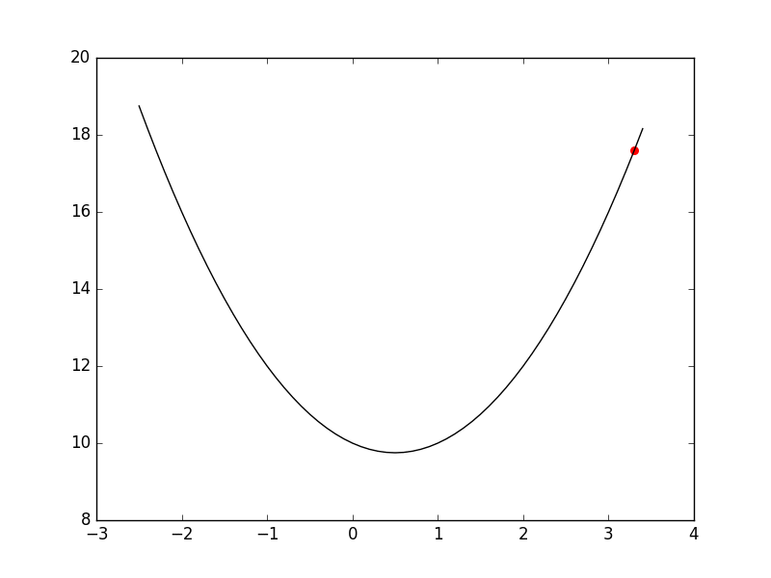
线搜索 无约束凸优化的一阶方法
一维例子
1. 过(w, obj(w))点做obj函数的切线，斜率是$\frac{dobj}{dw}$
2. 过(w, obj(w))点做辅助线g(w)，斜率是$\frac{1}{3}\frac{dobj}{dw}$，
3. $η=$1，直至obj(w-$η\frac{dobj}{dw}$) < g(w-$η\frac{dobj}{dw}$)重复$η=$0.8$η$
4. w$=w−η\frac{dobj}{dw}$，goto 1

Slide 32
牛顿法 无约束凸优化的二阶方法
牛顿法解方程f(x) = 0
过(x, f(x))做f(x)的切线，斜率是$f^{′}(x)$
切线与x轴相交在t = x - $\frac{f(x)}{f^{′}(x) }$处
x = t，goto 1

Slide 33
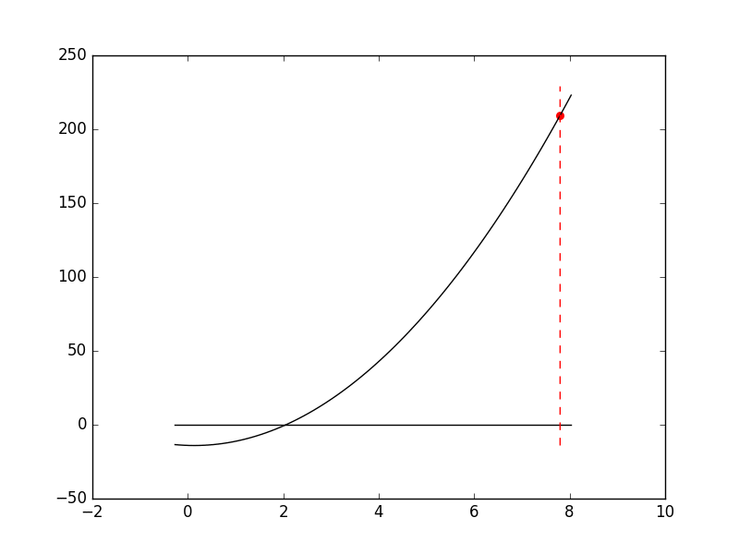
牛顿法 无约束凸优化的二阶方法
牛顿法解方程f(x) = 0
过(x, f(x))做f(x)的切线，斜率是$f^{′}(x)$
切线与x轴相交在t = x - $\frac{f(x)}{f^{′}(x) }$处
x = t，goto 1

Slide 34
牛顿法 无约束凸优化的二阶方法
牛顿法求obj(w)的最小值，等同于解方程$\frac{dobj}{dw}$=0
w = w - $\frac{\frac{dobj}{dw}}{ \frac{d^{2}obj}{d^{2}w} }$

Slide 35
随机梯度下降 大规模数据上常用方法
目前为止，梯度是基于全部数据进行计算，进行参数更新
随机梯度下降，基于部分数据进行梯度计算，进行参数更新
适用于大规模问题

Slide 36
逻辑回归

Slide 37
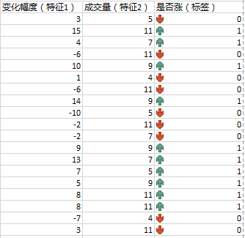
数据：特征+标签

Slide 38
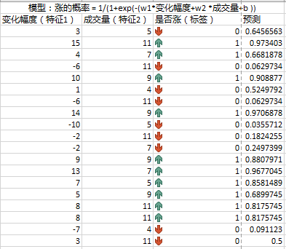
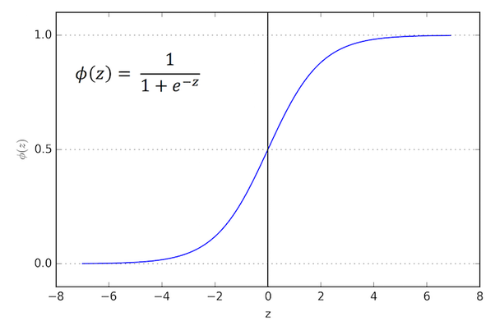
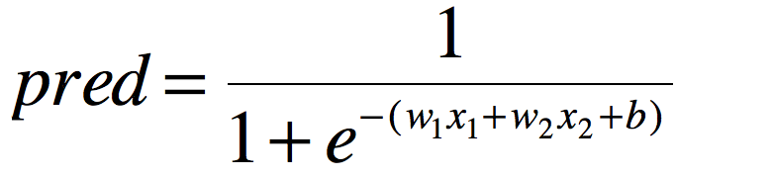
模型

Slide 39
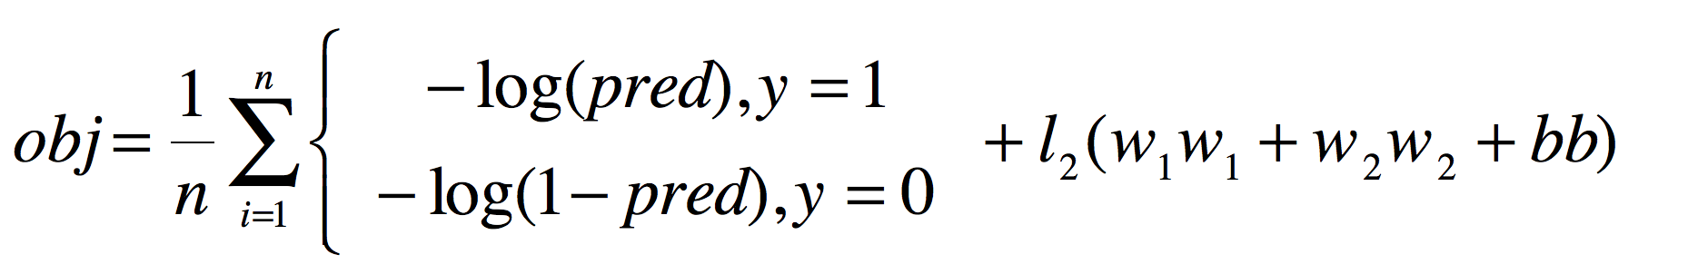
目标

Slide 40
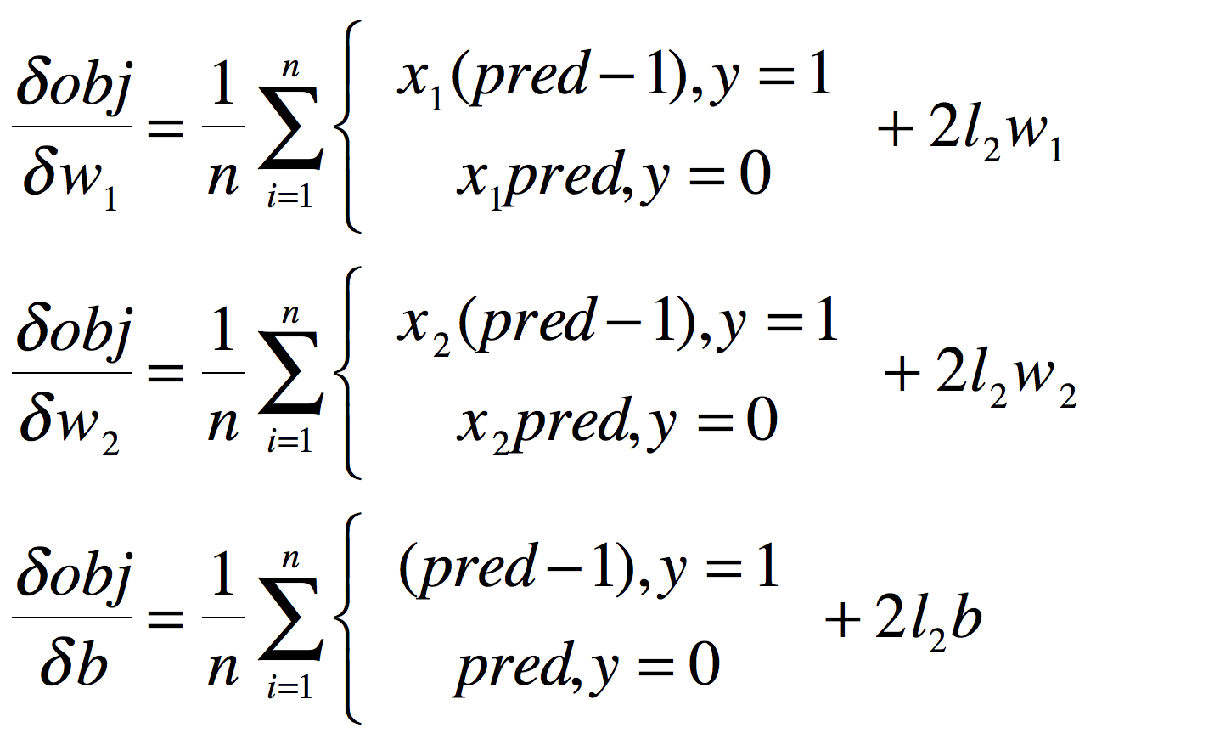
优化器
算出梯度，优化起来

Slide 41
多分类问题

Slide 42
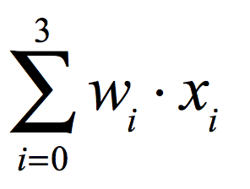
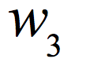
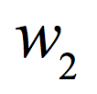
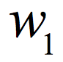
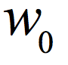
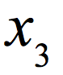
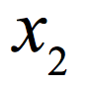
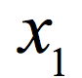
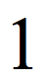

Slide 43
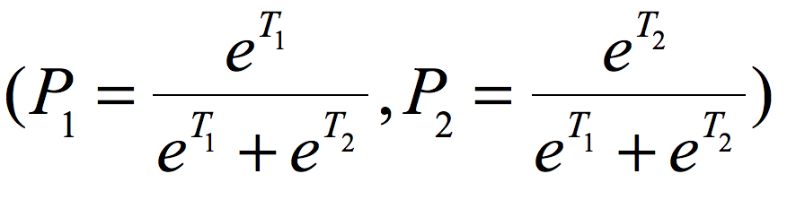
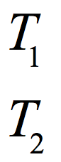
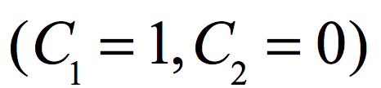
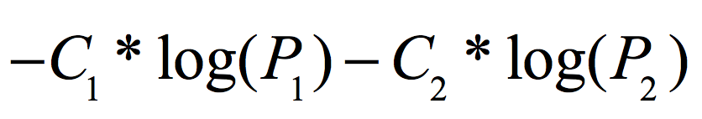
由两（几）个数字变成
在分类上的概率： softmax
实际标签
距离

Slide 44
从数据到模型
数据分布
不同标签数量
不同标签数据分布
数据异常值
数据缺失

Slide 45
练习：wine
降维
Kmeans
分类

Slide 46
实践
注意事项：PCA的数据必须是均值0的数据

Slide 47
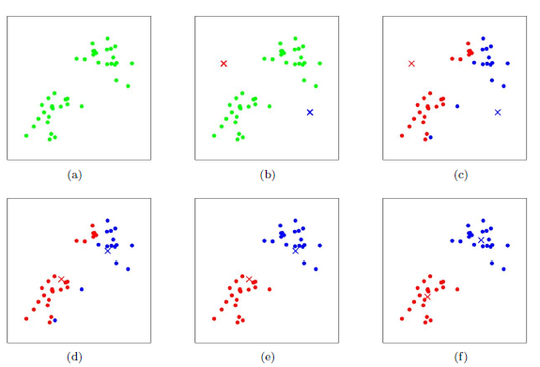
K-means

Slide 48
实践
思考
类数应该如何确定

Slide 49
实践
分割数据集
进行分类学习

Slide 50
Thank you

